Slide 1
Chapter 11 Sampling Methods

Slide 2
Contents
11.1 Basic Sampling Algorithms
11.2 Markov Chain Monte Carlo
11.3 Gibbs Sampling
11.4 Slice Sampling
11.5 The Hybrid Monte Carlo Algorithm
11.6 Estimating the Partition Function

Slide 3



Introduce
In Chapter 10, we discussed inference algorithms based on deterministic approximations, here we consider approximate inference methods based on numerical sampling.
The fundamental problem that we therefore wish to address in this chapter involves finding the expectation of some function $f(z)$with respect to a probability distribution $p(z)$.

Slide 4










11.1 Basic Sampling Algorithms
Standard distributions
$$z\sim U(0,1)$$
Example of exponential distribution
The generalization to multiple variables is straightforward and involves the Jacobian of the change of variables, so that
Notes:
Obviously, the transformation technique depends for its success on the ability to calculate and then invert the indefinite integral of the required distribution. Such operations will only be feasible for a limited number of simple distributions, and so we must turn to alternative approaches in search of a more general strategy. Here we consider two techniques called rejection sampling and importance sampling.

Slide 5

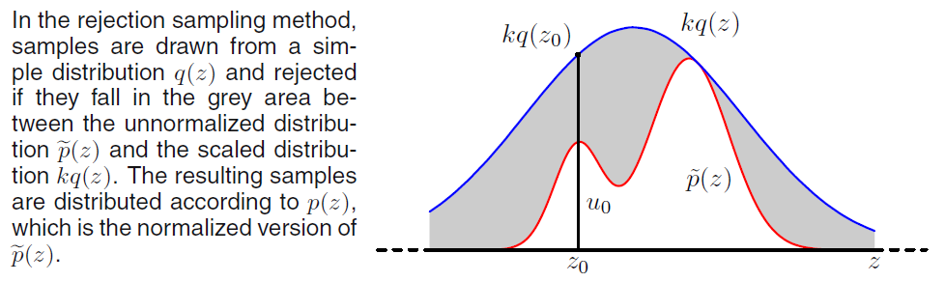
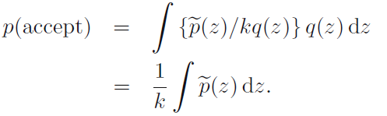
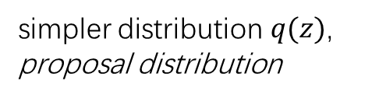
11.1 Basic Sampling Algorithms
Rejection sampling
The rejection sampling framework allows us to sample from relatively complex distributions, subject to certain constraints.
Introduce $q\left(z\right)$ and $k$; $z_{0}$ from $q\left(z\right)$, $u_{0}$ from $\left(0,kq\left(z_{0}\right)\right)$; if $u_{0}>\tilde{p}(z_{0})$, reject
simpler distribution $q(z)$,
proposal distribution
Notes:
Suppose we wish to sample from a distribution p(z) that is not one of the simple, standard distributions considered so far. that sampling directly from p(z) is difficult.
we are easily able to evaluate p(z) for any given value of z, up to some normalizing constant Z (unknown)

Slide 6


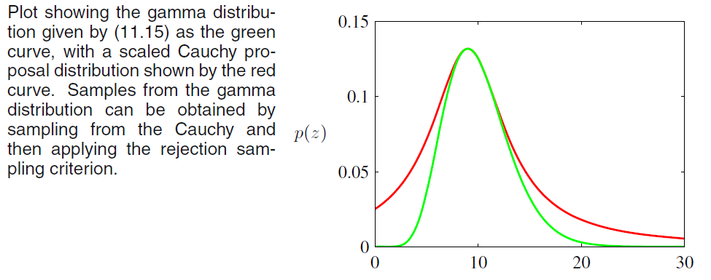
11.1 Basic Sampling Algorithms
Rejection sampling
As an illustration of the use of rejection sampling, consider the task of sampling from the gamma distribution

Slide 7
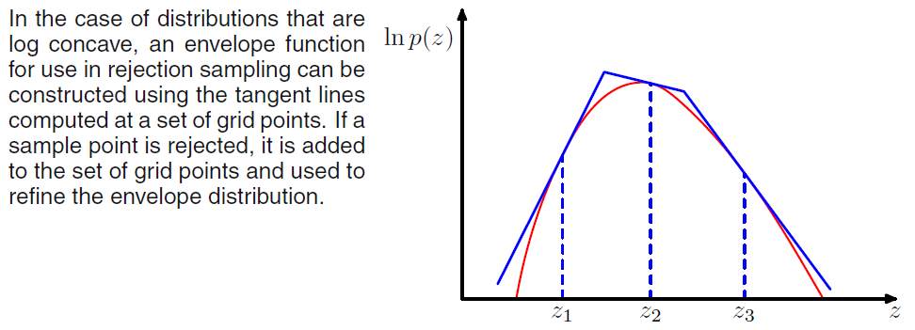

11.1 Basic Sampling Algorithms
Adaptive rejection sampling
In many instances, it proves difficult to determine a suitable analytic form for the envelope distribution $q(z)$.
for cases in which $p(z)$ is log concave

Slide 8

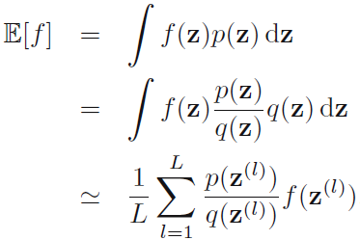

11.1 Basic Sampling Algorithms
Importance sampling
Importance sampling provides a framework for approximating expectations directly but does not itself provide a mechanism for drawing samples from distribution $p(z)$.
As in the case of rejection sampling, importance sampling is based on the use of a proposal distribution $q(z)$from which it is easy to draw samples.
are known as importance weights, and they correct the bias introduced by sampling from the wrong distribution.
Notes:
Suppose that it is impractical to sample directly from p(z) but that we can evaluate p(z) easily for any given value of z.

Slide 9


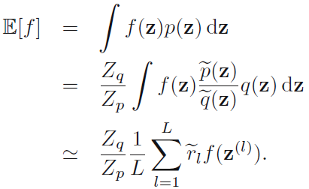
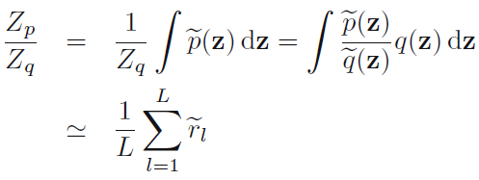


11.1 Basic Sampling Algorithms
Importance sampling
It will often be the case that the distribution $p(z)$ can only be evaluated up to a normalization constant.
can be evaluated easily.
where
Notes:
As with rejection sampling, the success of the importance sampling approach depends crucially on how well the sampling distribution q(z) matches the desired distribution p(z).

Slide 10

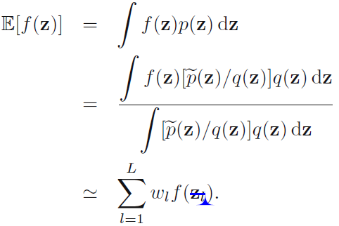
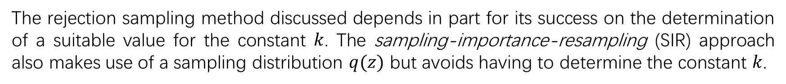
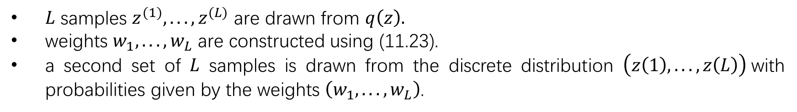
11.1 Basic Sampling Algorithms
Sampling-importance-resampling
The rejection sampling method discussed depends in part for its success on the determination of a suitable value for the constant $k$. The sampling-importance-resampling (SIR) approach also makes use of a sampling distribution $q(z)$ but avoids having to determine the constant $k$.
$L$ samples $z^{(1)}, . . . , z^{(L)}$ are drawn from $q\left(z\right).$
weights $w_{1}, . . . , w_{L}$ are constructed using (11.23).
a second set of $L$ samples is drawn from the discrete distribution $\left(z\left(1\right), . . . , z\left(L\right)\right)$with probabilities given by the weights $\left(w_{1}, . . . , w_{L}\right)$.
If moments with respect to the distribution $p(z)$ are required

Slide 11
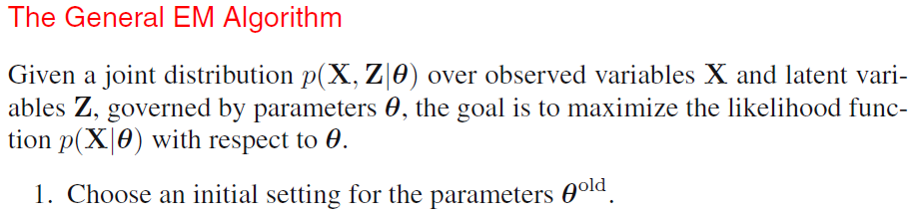
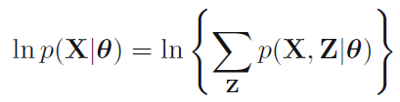
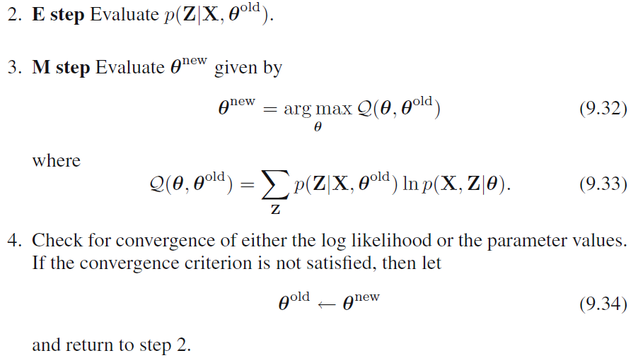
11.1 Basic Sampling Algorithms

Slide 12



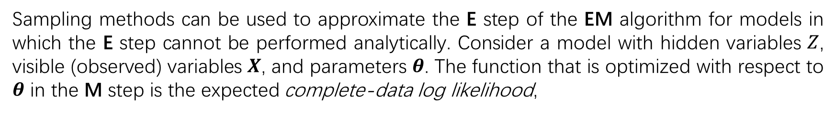
11.1 Basic Sampling Algorithms
Sampling and the EM algorithm
Sampling methods can be used to approximate the E step of the EM algorithm for models in which the E step cannot be performed analytically. Consider a model with hidden variables $Z$, visible (observed) variables $X$, and parameters $θ$. The function that is optimized with respect to $θ$ in the M step is the expected complete-data log likelihood,
Use samples $\left\{Z^{\left(l\right)}\right\}$ drawn from the current estimate for the posterior distribution
The $Q$ function is then optimized in the usual way in the M step. This procedure is called the Monte Carlo EM algorithm.

Slide 13
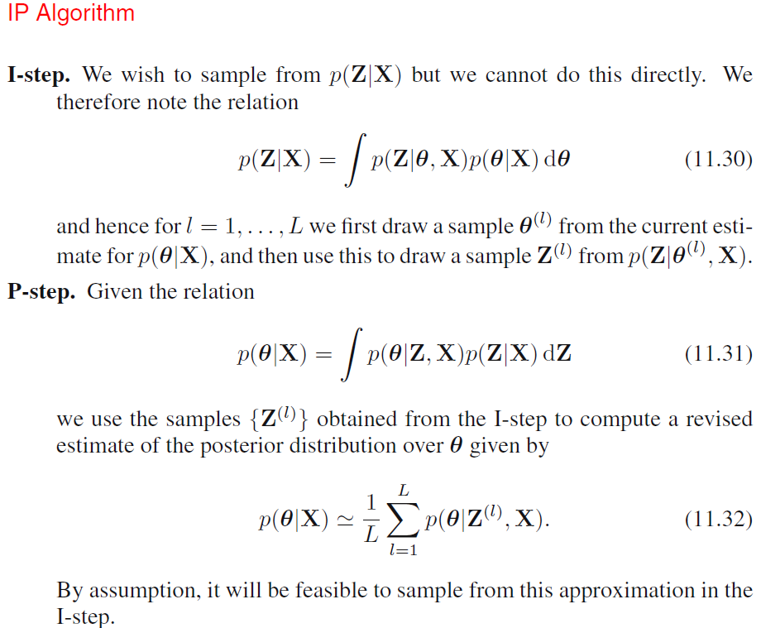
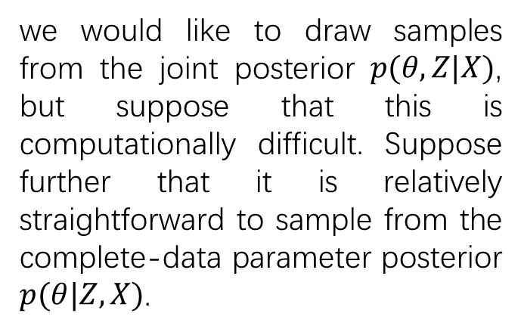
11.1 Basic Sampling Algorithms
Sampling and the EM algorithm
A full Bayesian treatment
we would like to draw samples from the joint posterior $p(θ,Z|X)$, but suppose that this is computationally difficult. Suppose further that it is relatively straightforward to sample from the complete-data parameter posterior $p(θ|Z,X)$.
imputation step
posterior step

Slide 14




11.2 Markov Chain Monte Carlo
Markov chains
conditional independence property
Transition probabilities
Marginal probability
For a homogeneous Markov chain with transition probabilities $T(z^{′},z),$the distribution $p(z)$ is invariant if
detailed balance
A Markov chain that respects detailed balance is said to be reversible.

Slide 15



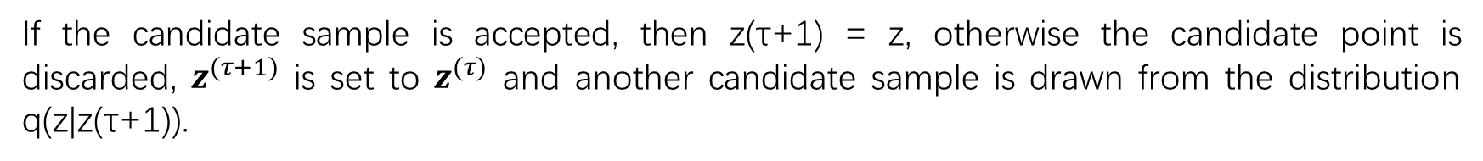
11.2 Markov Chain Monte Carlo
The Metropolis-Hastings algorithm
At step $τ$ he current state is $z^{(τ)}$, we draw a sample $z$ from the proposal distribution $q_{k}(z|z^{(τ)})$ and then accept it with probability
choose a random number $u$ with uniform distribution over the unit interval $(0, 1)$ and then accepting the sample if
If the candidate sample is accepted, then z(τ+1) = z, otherwise the candidate point is discarded, $z^{(τ+1)}$ is set to $z^{(τ)}$ and another candidate sample is drawn from the distribution q(z|z(τ+1)).

Slide 16
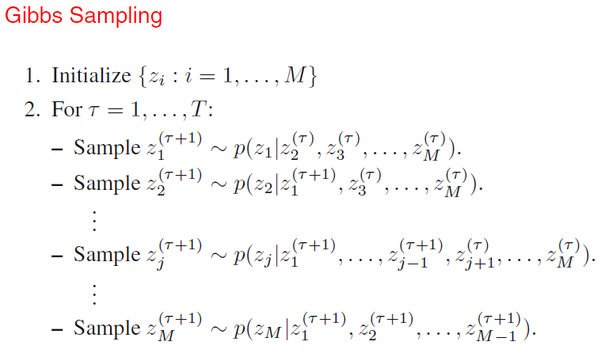
11.3 Gibbs Sampling
Gibbs sampling is a simple and widely applicable Markov chain Monte Carlo algorithm and can be seen as a special case of the Metropolis-Hastings algorithm.
Each step of the Gibbs sampling procedure involves replacing the value of one of the variables by a value drawn from the distribution of that variable conditioned on the values of the remaining variables.

Slide 17



11.4 Slice Sampling
One of the difficulties with the Metropolis algorithm is the sensitivity to step size. If this is too small, the result is slow decorrelation due to random walk behavior, whereas if it is too large the result is inefficiency due to a high rejection rate.
The technique of slice sampling provides an adaptive step size that is automatically adjusted to match the characteristics of the distribution.
The univariate case
augment $z$ with an additional variable $u$ and then drawing samples from the joint $(z, u)$ space.
sample uniformly from the area under the distribution
The marginal distribution over $z$

Slide 18
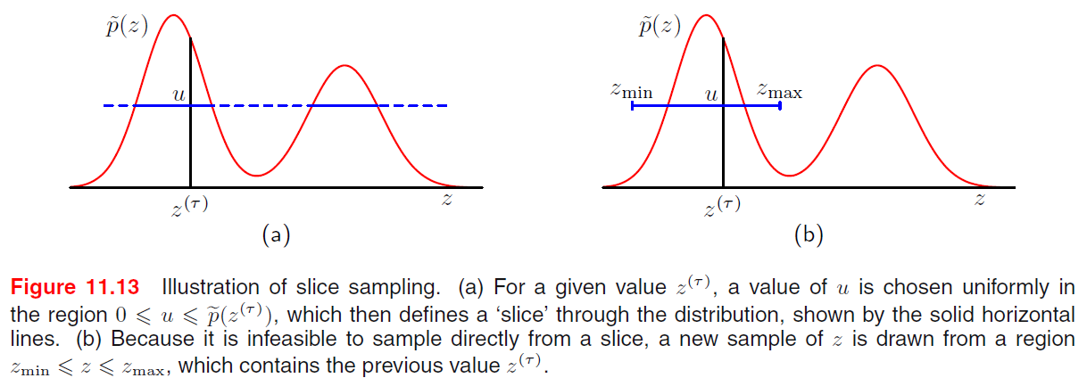
11.4 Slice Sampling

Slide 19





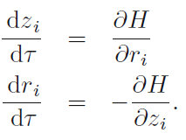


11.5 The Hybrid Monte Carlo Algorithm
Dynamical systems
$z=\left\{z_{i}\right\}, r=\{r_{i}\}$
the probability distribution
$E(z)$is interpreted as the potential energy
define the kinetic energy by
The total energy of the system is then the sum of its potential and kinetic energies
Hamiltonian function
Hamiltonian equation
Notes:
As we have already noted, one of the major limitations of the Metropolis algorithm is that it can exhibit random walk behavior whereby the distance traversed through the state space grows only as the square root of the number of steps. The problem cannot be resolved simply by taking bigger steps as this leads to a high rejection rate.

Slide 20
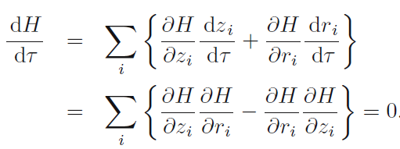

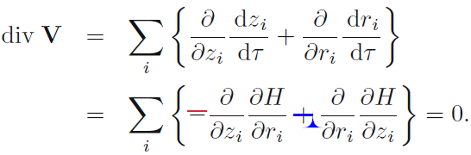

11.5 The Hybrid Monte Carlo Algorithm
Dynamical systems
The value of the Hamiltonian $H$ is constant.
Liouville’s Theorem, Hamiltonian systems preserve volume in phase space.
A region within the space of variables $(z,r),$ then as this region evolves under the equations of Hamiltonian dynamics, its shape may change but its volume will not.

Slide 21

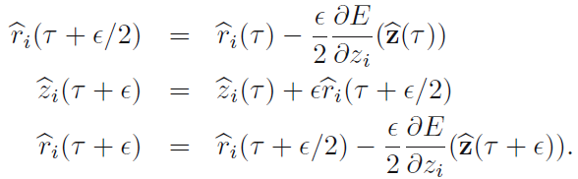
11.5 The Hybrid Monte Carlo Algorithm
Dynamical systems
Now consider the joint distribution over phase space whose total energy is the Hamiltonian, i.e., the distribution given by
In order to arrive at an ergodic sampling scheme, we can introduce additional moves in phase space that change the value of $H$ while also leaving the distribution $p(z, r)$ invariant.
to replace the value of $r$ with one drawn from its distribution conditioned on $z$. Gibbs sampling step
$z$ and $r$ are independent in the distribution $p(z, r)$, the conditional distribution $p(r|z)$ is a Gaussian from which it is straightforward to sample.
leapfrog discretization

Slide 22

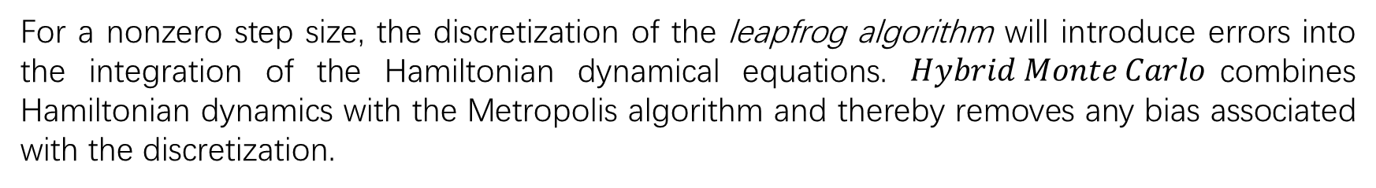
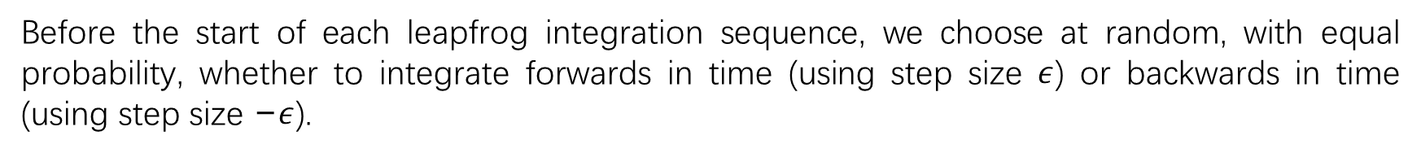
11.5 The Hybrid Monte Carlo Algorithm
Hybrid Monte Carlo
For a nonzero step size, the discretization of the leapfrog algorithm will introduce errors into the integration of the Hamiltonian dynamical equations. $Hybrid Monte Carlo$combines Hamiltonian dynamics with the Metropolis algorithm and thereby removes any bias associated with the discretization.
Before the start of each leapfrog integration sequence, we choose at random, with equal probability, whether to integrate forwards in time (using step size $ε$) or backwards in time (using step size −$ε$).
After each application of the leapfrog algorithm,

Slide 23

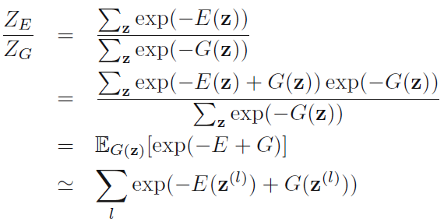
11.6 Estimating the Partition Algorithm
The normalization constant $Z_{E}$ is also known as the partition function.
Assume that direct evaluation by summing, or integrating, the function $exp⁡(−E(z))$ over the state space
of $z$ is intractable.
For model comparison, it is actually the ratio of the partition functions for two models that is required. Multiplication of this ratio by the ratio of prior probabilities gives the ratio of posterior probabilities, which can then be used for model selection or model averaging.
use importance sampling from a distribution with energy function $G(z)$
Notes:
As we have seen, most of the sampling algorithms considered in this chapter require only the functional form of the probability distribution up to a multiplicative constant.

